Slide 1
HL7 Training
Presented By:
Lucía Lapaz, Brittany Ersery & Jim Holsinger
Envision Technology Partners, Inc.
September 2019

Slide 2
Agenda
HL7 Messaging Overview
HL7 Message Format
HL7 User Settings and Facility Setup
HL7 Message Execution and Monitoring
Traffic Analyzer
Interface Activity Reports

Slide 3
HL7 Messaging Overview

Slide 4
Overview
HL7 (Health Level 7) is an approved ANSII standard for messages containing health-related information
WebIZ supports synchronous (real-time) messaging via web service and batch messaging
HL7 messaging allows other systems to query and update records in WebIZ via a web service

Slide 5
Overview (cont.)
The HL7 messaging formats used in WebIZ are based on:
Health Level Seven (HL7) Standard Protocol (http://www.hl7.org)
CDC’s HL7 2.5.1 Implementation Guides for Immunization Messaging (http://www.cdc.gov/vaccines/programs/iis/technical-guidance/hl7.html)

Slide 6
HL7 Messaging Uses
Incoming (EMR → WebIZ) – updates or new patient records
Receive immunization history
Accept demographic data
Outgoing (WebIZ → EMR) – in response to a query or update
Return evaluated immunization history and forecast
Send demographic data
Acknowledge receipt
Report error

Slide 7
Data Maintenance
Every EMR that is connected through the interface is responsible for their own data maintenance
Data quality, De-duplication, etc.
Coordination is necessary
ShowMeVax staff will need to work with Providers to resolve data quality issues
If not, data “cleaned” in WebIZ could be overwritten by “dirty” data coming from EMRs
If potential duplicates (both patient and immunization) are not monitored regularly, they could begin to multiply

Slide 8
HL7 Message Format

Slide 9
HL7 Message Format
HL7 Message
Segment
Field
Field
Segment
Field
Component
Component
Component
Component
Component
Component

Slide 10
HL7 Message Format (cont.)
Messages are a series of segments
Each message definition specifies which segments are applicable, the order they must occur in, which are required vs. optional, etc.
Segments are groupings of fields
A segment may occur in multiple message types
The definition of a segment is the same regardless of the message in which it occurs
Fields consist of one or more components
A field may occur in multiple segment types
The definition of a field is the same regardless of the segment in which it occurs

Slide 11
HL7 Message Format (cont.)
Segment
Component
Field

Slide 12
HL7 Message Format: Special Characters
<CR> Segment Terminator
| Field Terminator
^ Component Terminator
~ Repetition Terminator

Slide 13
HL7 2.5.1 Message Types
Message Type | Purpose
VXU | Send Immunization History (Update)
QBP | Request Immunization History / Request Evaluated History and Forecast (Query)
RSP | Respond to Request for Immunization Record and Respond to Request for Person ID (Response to Query)
ACK | Send Message Acknowledgement

Slide 14
Sample VXU (Update) Message
MSH|^~\&|TestApplication|MO9999|WebIZ|MODHSS|20190520152420.922-0600||VXU^V04^VXU_V04|MO999938854000000232|T|2.5.1|||ER|AL|||||Z22^CDCPHINVS
PID|1||000000002^^^MO9999^MR~111111111^^^MO9999^SS||SIMPSON^BART^M^^^^L||19990101|M
ORC|RE||9999^MODHSS
RXA|0|1|19990101||08^Hep B, ped/adol^CVX|0.5|mL^^UCUM||00^New admin^NIP001|^Sticker^Nurse^^^^^^^^^^^^^^^^^^RN|^^^MO9999||||lotnum|20000101|SKB^GlaxoSmithKline^MVX|||CP|A
RXR|C28161^Intramuscular^NCIT^IM^Intramuscular^HL70162|RT^Right Thigh^HL70163
OBX|1|CE|64994-7^Eligibility Status^LN|1|V02^Medicaid^HL70064||||||F|||19990101|||VXC40^vaccine level^CDCPHINVS
OBX|2|CE|30963-3^Vaccine funding source^LN|2|VXC51^Public VFC^NIP008||||||F|||19990101
OBX|3|CE|30956-7^vaccine type^LN|3|45^Hep B, UF^CVX||||||F|||19990101
OBX|4|TS|29768-9^VIS Publication Date^LN|3|19970101||||||F|||19990101
OBX|5|TS|29769-7^VIS Presentation Date^LN|3|19990101||||||F|||19990101

Slide 15
Sample QBP (Query) Message
MSH|^~\&|TestApplication|MO9999|WebIZ|MODHSS|20190520151346.540-0600||QBP^Q11^QBP_Q11|MO999938854000000232|T|2.5.1|||ER|AL|||||
Z44^CDCPHINVS
QPD|Z44^Request Evaluated History and Forecast^CDCPHINVS|querytag||SIMPSON^BART^^^^^L||19990101||
RCP|I|5^RD&records&HL70126|R^real-time^HL70394

Slide 16
HL7 User Settings and Facility Setup

Slide 17
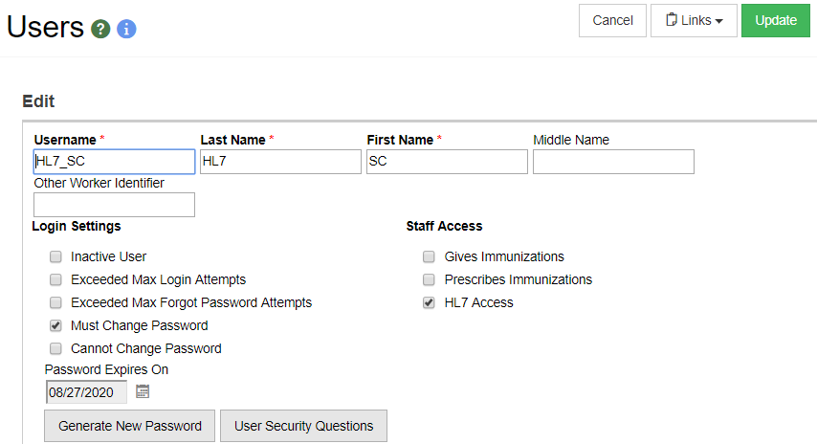
Setup HL7 User
Select the HL7 Access checkbox to setup the user that will be associated to the HL7 facility.

Slide 18
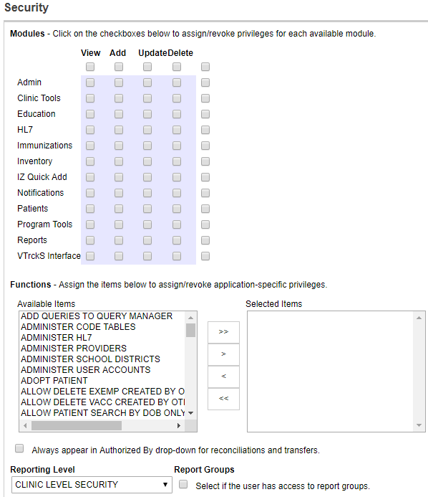
Setup HL7 User (cont.)
1
HL7 User Requirements:
No module access
No security functions
“Clinic Level Security” Reporting Level
This user will not be logging into SIMON and will only be connecting via Web Service.
2
3

Slide 19
Facility Codes
Unique values assigned to each system exchanging HL7 messages with SIMON
Used to distinguish messages from different sending facilities
Recommended format:
XX####
XX: two letter code for the jurisdiction (MO)
####: 4 digit number for the system
SIMON = SIMON
SC9999 = Test Facility (for sending test messages)

Slide 20
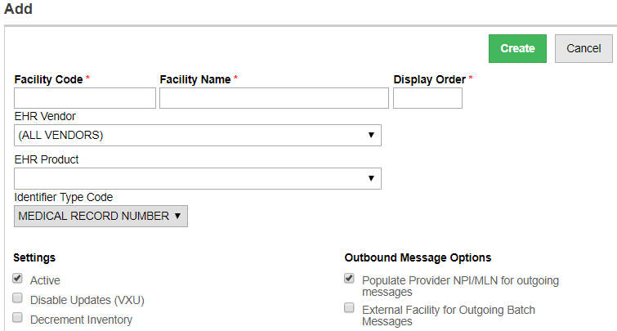
Add/Edit Facility Code
1
2
Unique Facility Code and Facility Name.
Select the EHR Vendor and EHR Product.

Slide 21
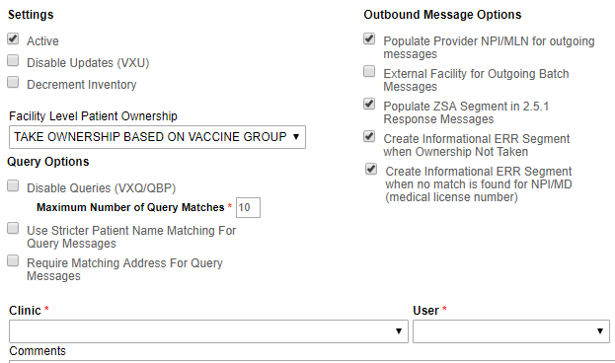
Add/Edit Facility Code
1
Select if Facility should decrement Clinic’s inventory.
Set Facility Level Patient Ownership.
Associate Facility to a Clinic.
Associate Facility to a User.
2
3
4

Slide 22
HL7 Message Execution and Monitoring

Slide 23
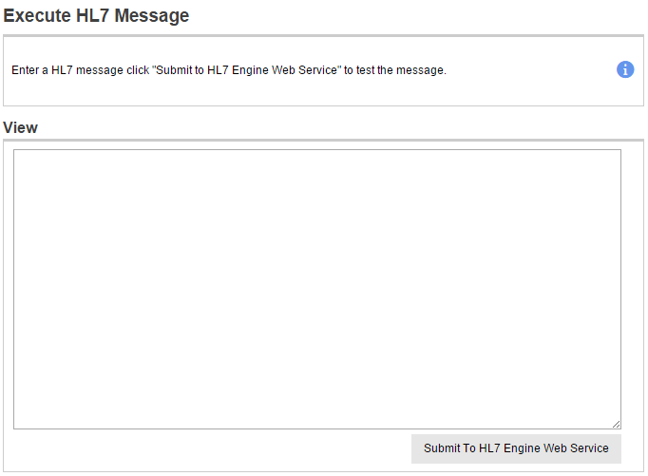
Execute HL7 Message
Submit a single message to the HL7 engine web service.

Slide 24
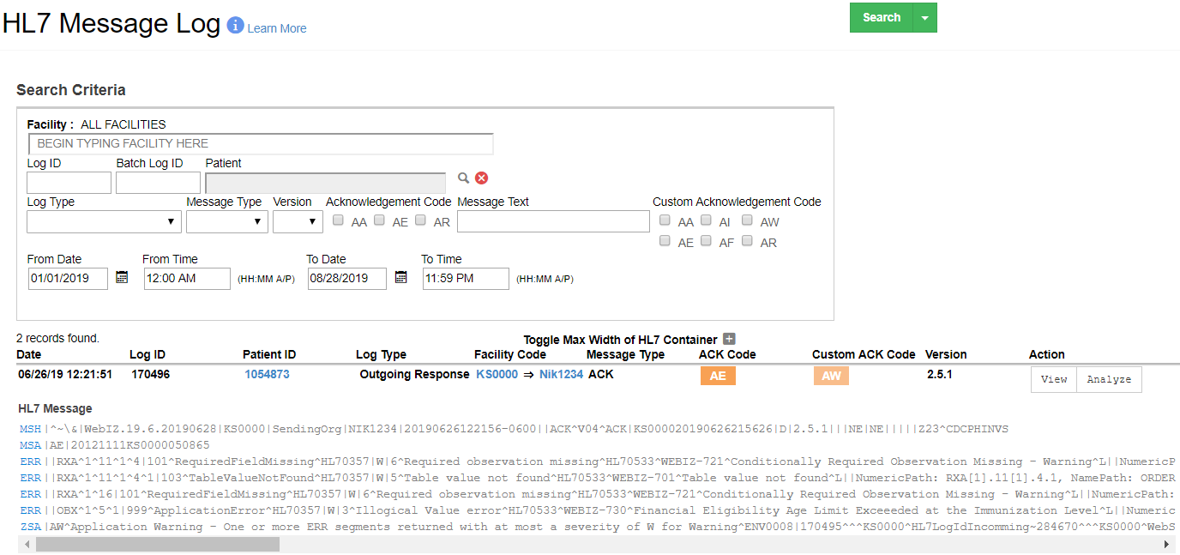
HL7 Message Log
1
2
Search HL7 messages.
Enter Search criteria.
View message in pop-up.
View message in analyzer.
3
4

Slide 25
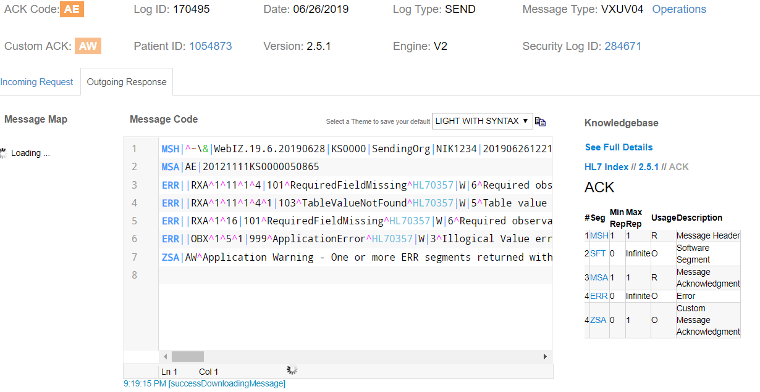
HL7 Message Analyzer
4
1
2
3
Link to Patient Demographics screen.
Link to Security Log.
Toggle between the original request and its response.
View vaccination consolidation/matching logic.

Slide 26
HL7 Message Analyzer
Expand/collapse Message Map to navigate to a segment or field
Warnings and errors are color-coded in the request message
Click on a warning or error to highlight the problem area in the message and view details

Slide 27
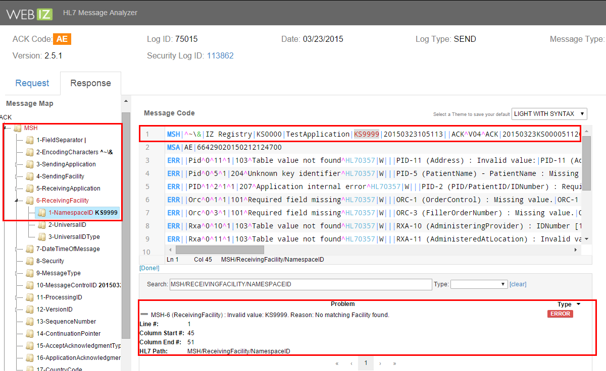
Click warning or error message to highlight problem area.

Slide 28
Execute HL7 Message
Hands-On Exercise

Slide 29
HL7 Batch Messaging

Slide 30
Batch (Incoming)
1
2
Click to add a new batch file for processing.
Enter criteria and search for uploaded and/or processed batch files.

Slide 31
Batch (Incoming) – Add
2
1
Click Choose File to upload a batch file.
Click Create to queue the batch file for processing.

Slide 32
Batch (Incoming) – Results
1
3
2
Run Date/Time indicates when batch file was processed.
Click file name hyperlink to download the batch file.
Total VXU messages, Errors, and Warnings are provided.

Slide 33
Batch (Outgoing)
1
2
Click to create a new outgoing batch file.
Enter criteria and search for outgoing batch files.

Slide 34
Batch (Outgoing) – Add
3
1
Select HL7 version.
Select Receiving Facility.
Click Create to queue the batch file for processing.
2

Slide 35
Batch (Outgoing) – Results
1
3
2
Run Date/Time indicates when batch file was processed.
Click file name hyperlink to download the batch file.
Total number of Errors and Warnings is displayed.

Slide 36
Traffic Analysis

Slide 37
Performance Map
Used to compare providers’ HL7 message quality.
Filter results by:
Date Range
View (Provider, Facility, HER)
Message Type (Update, Batch, Query)
Can be exported to Excel

Slide 38
Performance Map (cont.)
Move slider to change error colors.
Click on Provider or Facility code link to investigate further.

Slide 39
HL7 Profile
Displays a summary of Providers’ messages.
Response messages (ZSA segments)
Updates/Queries
Immunizations created/updated
Grade
Filter results by:
Date Range
View (Provider, Facility, HER)
Message Type (Update, Batch, Query)
Can be exported to Excel

Slide 40
HL7 Profile (cont.)
Toggle between different profile types
Click on Provider link to investigate further.

Slide 41
HL7 Quality
Graphically displays message trends
ACK Codes
Immunizations created/updated
Error messages
Filter results by:
Date Range
Message Type (Update, Batch, Query)
Can be exported to Excel

Slide 42
HL7 Quality (cont.)
Mouse over a graph to view counts for specific dates
Click on Provider link to investigate further.

Slide 43
Interface Activity-Clinic Reports

Slide 44
HL7 Acknowledgement (ACK) Messages
Search for ACK messages to review in more detail
Filter results by acknowledgement code:
AA (Application Accept)
AE (Application Error)
AR (Application Reject)
Extract output can be parsed out as needed

Slide 45
HL7 Activity
View a summary of HL7 activity per provider/clinic
Report calculates total messages by:
Message Type
Log Type (Sent or Received)
Also a datamart version

Slide 46
HL7 Facility Codes
Search for HL7 facility codes by:
Provider/Clinic
User
Status
Available as PDF or extract

Slide 47
Interface Activity - Clinic Reports
Hands-On Exercise

Slide 48
Interface Activity - Admin Reports

Slide 49
Export HL7 Code Tables
Generates an excel workbook for selected HL7 code table settings
Output used to ensure QA code table values match Production values during Provider onboarding

Slide 50
Interface Activity - Admin Reports
Hands-On Exercise

